Slide 1

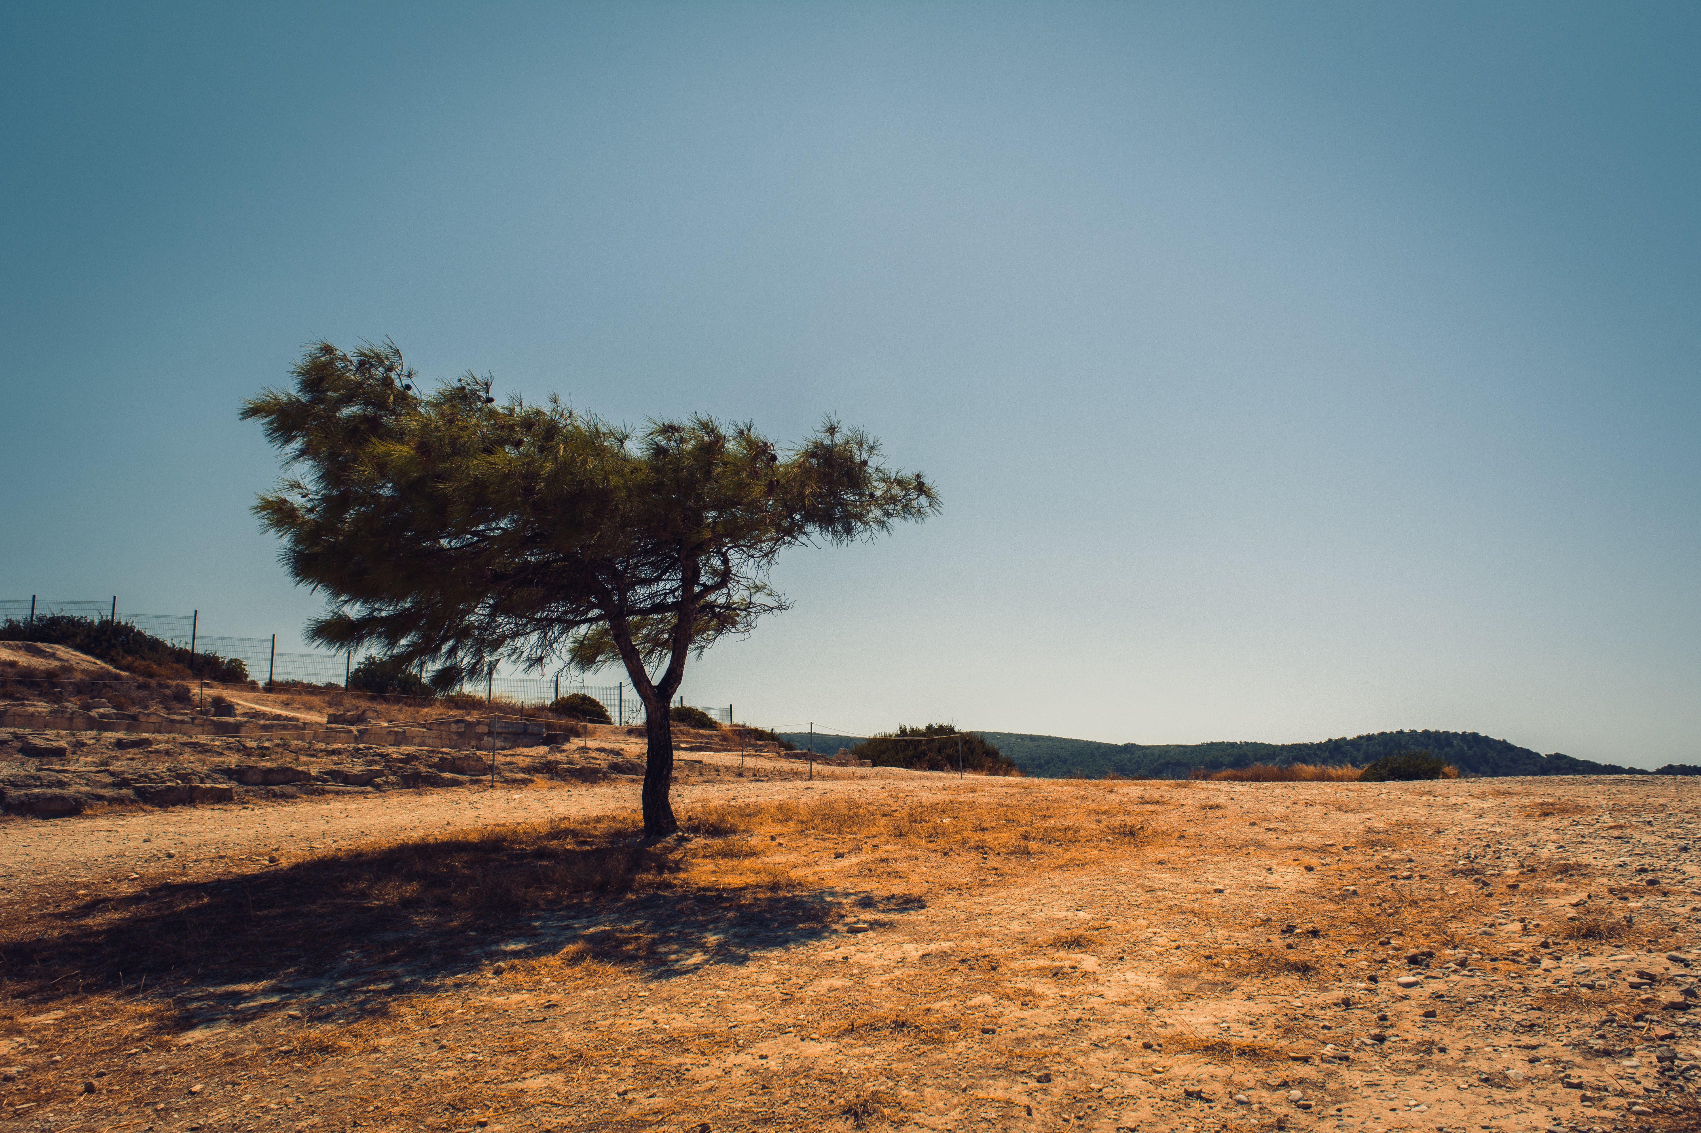
Here we have:
A video introducing the value of water.
An interactive visualization shows the water consumption in Australia.

Slide 2
Embeded youtube video
<iframe width="560" height="315" src="https://www.youtube.com/embed/SkAhB-8CtZg" frameborder="0" allow="accelerometer; autoplay; encrypted-media; gyroscope; picture-in-picture" allowfullscreen></iframe>
Do you know?
Fresh water is one of the most valuable resources to human. Drought may dramatically influence the water supply. People and properties in drought areas may be threatened by the shortage of water supply. Play the video on the right, which tells you the value of water. Please save the water in your daily life so that people who are affected by drought can be saved.

Slide 3
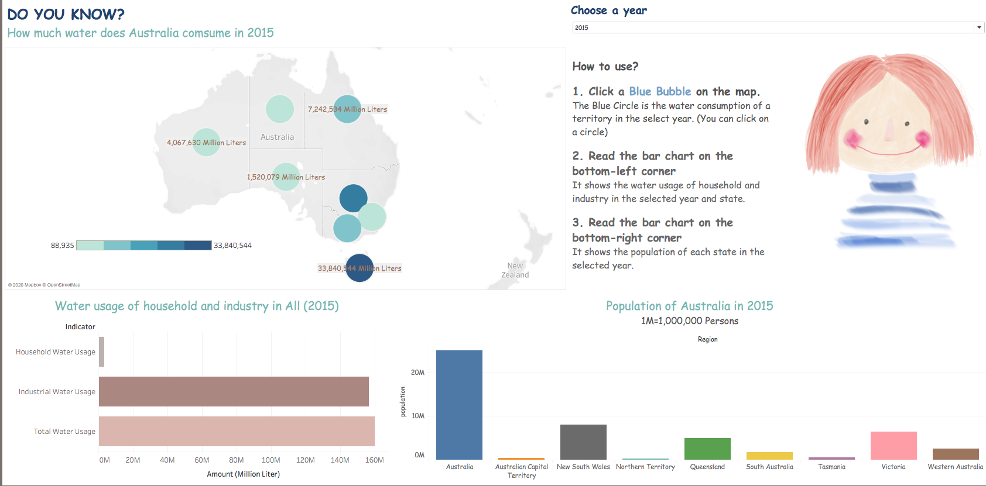
Notes:
https://public.tableau.com/views/Water_15993858642510/Water_01_V1?:language=zh-Hans&:display_count=y&publish=yes&:origin=viz_share_link

